Slide 1
Thesis and Dissertation Workshop
Jeffrey A. Potteiger, Ph.D., FACSM
Dean of The Graduate School
Mark Luttenton, Ph.D.
Associate Dean of the Graduate School
Grand Valley State University

Slide 2
Workshop overview
Introduction to the thesis and dissertation
Overview of policies and procedures
Responsibilities
Developing a topic
Formatting the document
Writing skills for your thesis or dissertation
Finalizing the process
Student resources for success

Slide 3
What is the purpose of a thesis or dissertation?
Complete a degree requirement
Contribute to the existing body of scholarly knowledge
Prepare for future research and scholarly activity
Fulfill requirements for a future degree
Create intellectual property
Solve a problem or answer a question

Slide 4
Introduction to the thesis and dissertation
https://www.gvsu.edu/gs/thesis-and-dissertation-information-35.htm

Slide 5
What are the unique challenges and how do you overcome those challenges
Finding time
Develop good time management skills
Regular meetings with faculty mentor
Finding resources
Search early for internal and external support
Identifying the research or scholarly question
Read the literature
Communicate with the experts in the area
Talk with your advisor regularly

Slide 6
Overview of policies and procedures
https://www.gvsu.edu/gs/policies-and-procedures-58.htm

Slide 7
Guidelines for the Preparation of Theses and Dissertations
https://www.gvsu.edu/gs/thesis-and-dissertation-information-35.htm

Slide 8
Policy for Enrollment
Project, Thesis, and Dissertation Credits and Workload
Programs must count a minimum of 3 project credits, 6 thesis credits, and 9 dissertation credits for a degree
Programs may count a maximum of 6 project credits, 9 thesis credits, and 12 dissertation credits for a degree
Students should enroll in the number of project, thesis, or dissertation credit hours per semester that is consistent with the following workload guideline: 1 credit hour is expected to average between 3-6 clock hours per week of work, or 45 – 90 clock hours per semester

Slide 9
Policy for Continuous Enrollment
Masters Thesis. Students begin the thesis phase of their program by enrolling in xxx-695. Thereafter, you must enroll in either xxx-695 or xxx-696 (Continuous Enrollment) for at least 1 credit every semester until you have completed all requirements for the thesis.
Doctoral project. Students begin the project phase of their program by enrolling in xxx-793 (Project). Thereafter, you must enroll in either xxx-793 or xxx-796 (Continuous Enrollment) for at least 1 credit hour every semester until you have completed all requirements for the project.
Doctoral dissertation. Students begin the dissertation phase of their program by enrolling in xxx-795 (Dissertation). Thereafter, you must enroll in either xxx-795 or xxx-796 (Continuous Enrollment) for at least 1 credit hour every semester until you have completed all requirements for the dissertation.

Slide 10
Credit hour fees
https://www.gvsu.edu/financialaid/tuition-fees-68.htm

Slide 11
RCR Training requirement
https://www.gvsu.edu/gs/responsible-conduct-of-research-requirements-88.htm

Slide 12
Human, animal, biosafety, laser, and radiation safety committee review
https://www.gvsu.edu/hrrc/
https://www.gvsu.edu/iacuc/
https://www.gvsu.edu/rci/

Slide 13
Research misconduct
The fabrication, falsification, or plagiarism in proposing, performing, or reviewing research, or in reporting research results
Engaging in ordering, advising or suggesting that subordinates engage in misconduct in research, scholarship or creative activities
Does not include honest error or differences of opinion
Does not cover authorship disputes unless they involve plagiarism

Slide 14
Research and publication policies
https://www.gvsu.edu/rcr/publication-practices-16.htm

Slide 15
University Policy 4.1.10.2 Rights in published material, inventions, and secret processes
Students and faculty have rights to intellectual property that has been developed in the course of the educational process
https://www.gvsu.edu/policies/policy.htm?policyId=7D843ECD-CF7B-B6B7-4D6440CABB997BD0&search=Intellectual%20Property

Slide 16
Time frame and deadlines
Develop a workable schedule that will allow you to meet the deadlines
https://www.gvsu.edu/gs/thesis-and-dissertation-information-35.htm

Slide 17
Funding support for graduate students
Financial support exists to help with research and scholarship
https://www.gvsu.edu/gs/presidential-research-grants-33.htm

Slide 18
Responsibilities – student
Know the program requirements
Identify a graduate faculty member to serve as the Committee Chairperson
Work with the Chairperson to identify graduate faculty who would make meaningful contributions to the development and completion of a thesis or dissertation
Fulfill the expectations of the Committee in regards to deadlines, completion of necessary forms and approvals, and the responsible conduct of scholarly or creative work with academic integrity
Defend all decisions regarding the purpose of the study, methodology, interpretation of results, and conclusions in a public defense that includes the Committee

Slide 19
Responsibilities – committee chair
Primary responsibility is to mentor the student with the goals of having the student:
complete a worthwhile project that has rigor
is appropriate for the student to complete within a reasonable amount of time during the academic program
challenges the student to develop and use the skills of critical inquiry, evidence-based decision making, reflection, presentation, and scholarly writing
Required to hold full graduate faculty status and be capable of, and/or experienced in, mentoring graduate students in scholarly activities

Slide 20
Responsibilities – committee chair
Responsible for calling Committee meetings, coordinating the activities of the Committee, and setting the tone for fair, honest, and equitable assessment of the student’s academic work
Has the key responsibility of working to ensure a successful, satisfactory outcome for both the student and the Committee

Slide 21
Responsibilities – committee members
Work with the student and Committee Chairperson to ensure a successful, satisfactory outcome that is assessed in a fair, honest, and equitable manner
Hold graduate faculty status and make active contributions to improve the project given their expertise and knowledge
Critically read and evaluate both the initial proposal and final documents, providing constructive feedback, editorial comment, and suggestions for improvement to the student and the Committee Chairperson in a collegial and timely manner

Slide 22
Committee membership
Theses - at least 3 members
Dissertations - at least 4 members.
Committee members must hold graduate faculty status
Chair of the committee - full graduate faculty status
At least one committee member must be from outside the specific research or disciplinary area of study
Dean of the Graduate School must approve non-graduate faculty as committee members
Non-graduate faculty members may include persons external to the university that are approved
The Graduate School must approve the committee membership

Slide 23
Proposal development
Thesis and dissertation proposals must be publicly presented
A thesis or dissertation announcement must be posted electronically on an academic program or departmental website
To have an announcement posted on The Graduate School website, email the announcement to gradschool@gvsu.edu
A thesis and dissertation proposal is considered to be complete when all committee members agree that the proposal is of sufficient quality and merit to warrant conducting the research, scholarship, or creative work

Slide 24
General formatting guidelines
https://www.gvsu.edu/cms4/asset/777A03CA-E5D1-90B3-8FF97B7EA6E9ECB3/guidelines_-_preparation_of_theses_and_dissertations_18-19_v9.pdf
Page 15

Slide 25
Manuscript vs. Traditional Formats
Manuscript
Chapter 1 – Introduction
Chapter 2 – Manuscript
Chapter 3 - Extended Review of Literature and Extended Methodology
Bibliography
Appendix
Traditional
Chapter 1 – Introduction
Chapter 2 – Review of Literature
Chapter 3 – Methodology
Chapter 4 – Results
Chapter 5 – Discussion
Chapter 6 – Conclusion
Bibliography
Appendix

Slide 26
Discipline specific formatting
https://www.gvsu.edu/gs/graduate-writing-resources-96.htm

Slide 27
Citations – choosing the correct style for your field/using that style correctly
https://www.gvsu.edu/gs/graduate-writing-resources-96.htm
Use a citation management tool
Bookends
EndNote
Mendeley
SciRef
Zotero
https://en.wikipedia.org/wiki/Comparison_of_reference_management_software

Slide 28
Writing skills for your thesis or dissertation
https://www.gvsu.edu/gs/graduate-writing-resources-96.htm

Slide 29
General writing skills
https://www.gvsu.edu/gs/graduate-writing-resources-96.htm

Slide 30
Graduate School writing resources
https://www.gvsu.edu/wc/writing-for-grad-school-95.htm

Slide 31
Developing a topic – how does one get started
https://www.gvsu.edu/cms4/asset/777A03CA-E5D1-90B3-8FF97B7EA6E9ECB3/tips_for_preparing_for_your_thesis_or_project_18-19.pdf

Slide 32
Brainstorming ideas
https://www.gvsu.edu/cms4/asset/CC3BFEEB-C364-E1A1-A5390F221AC0FD2D/brainstorming-with-comic.pdf

Slide 33
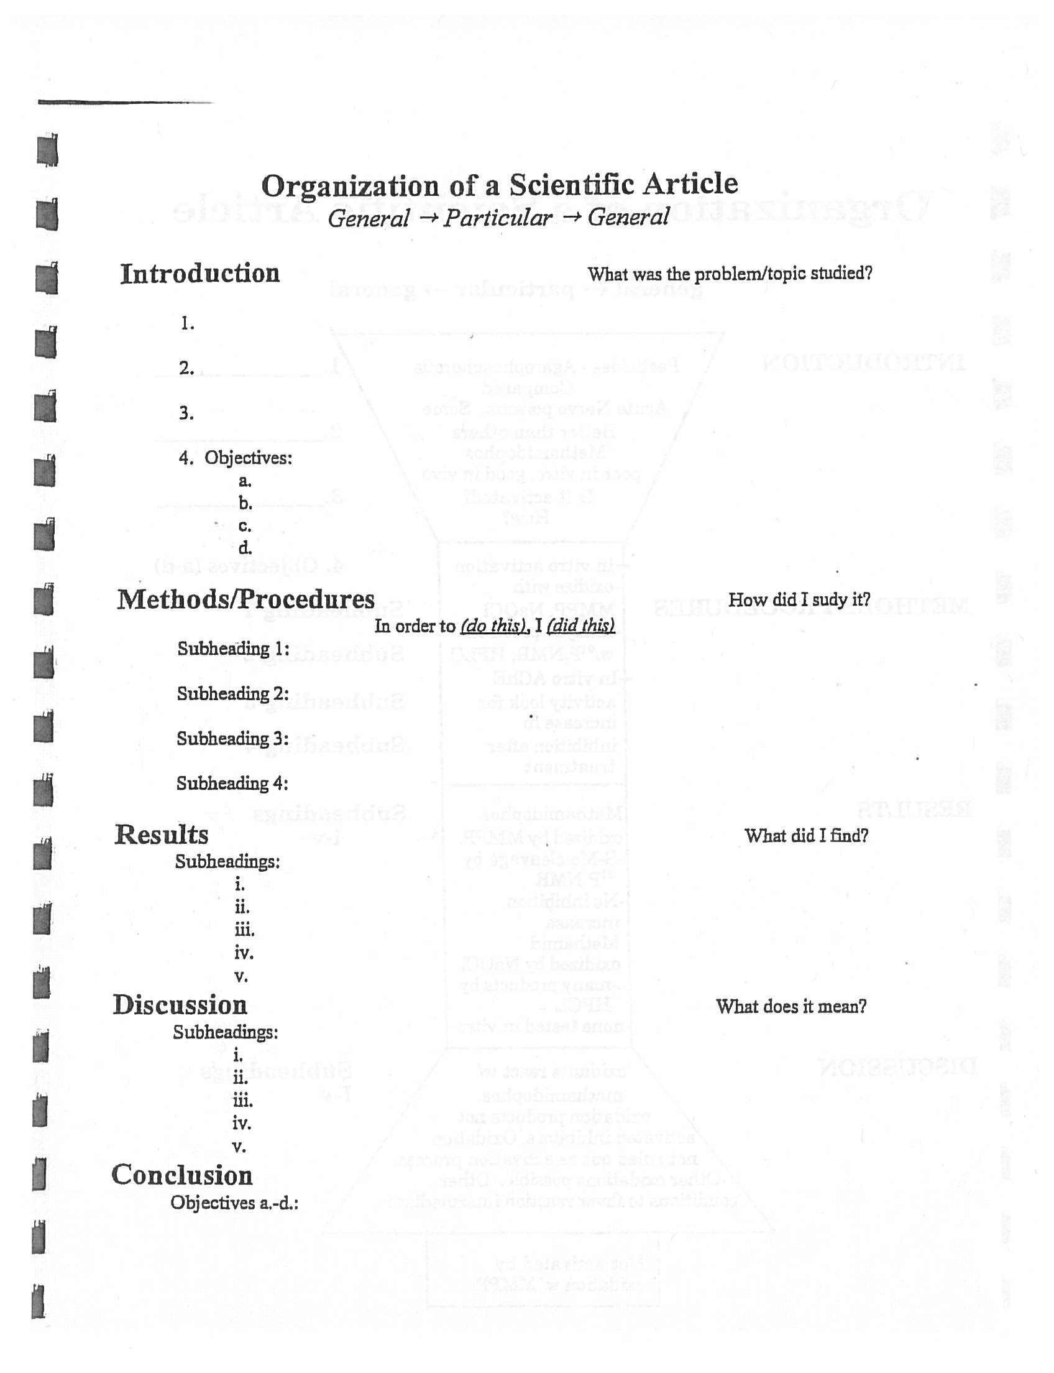
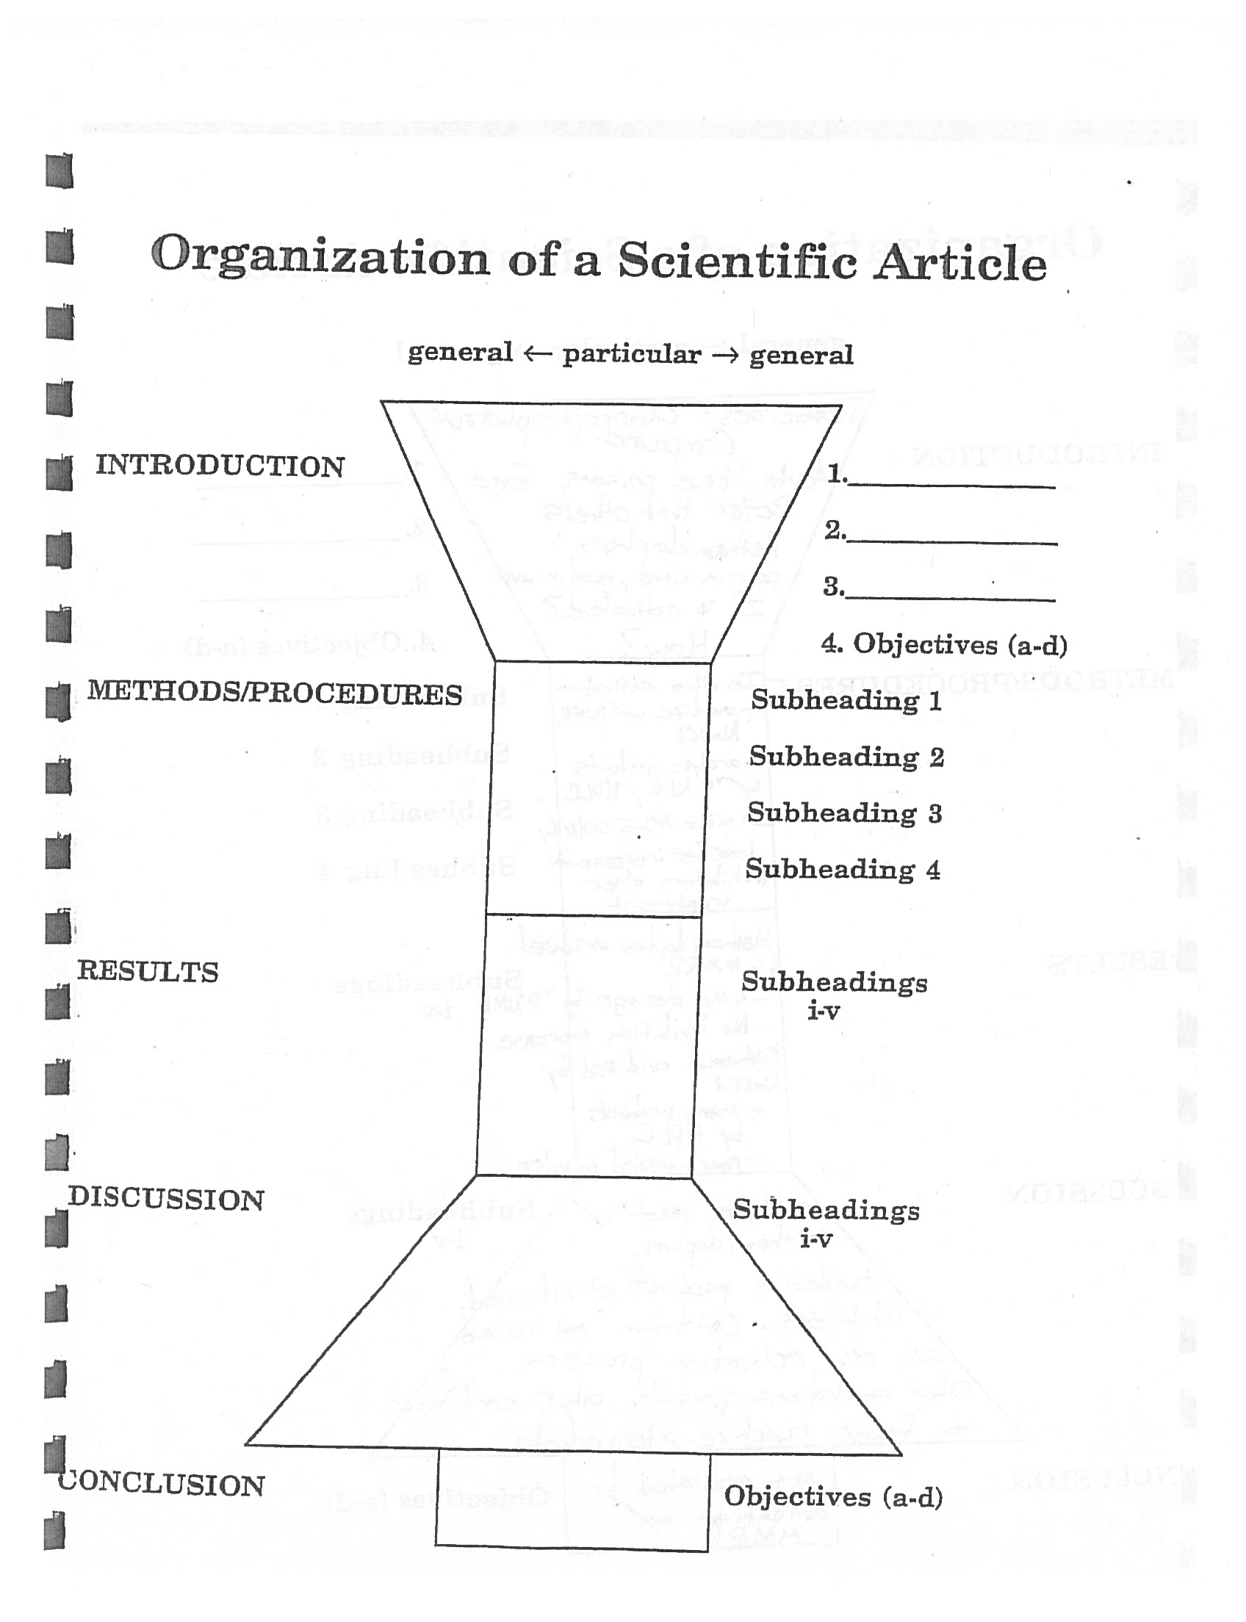
Getting Started

Slide 34

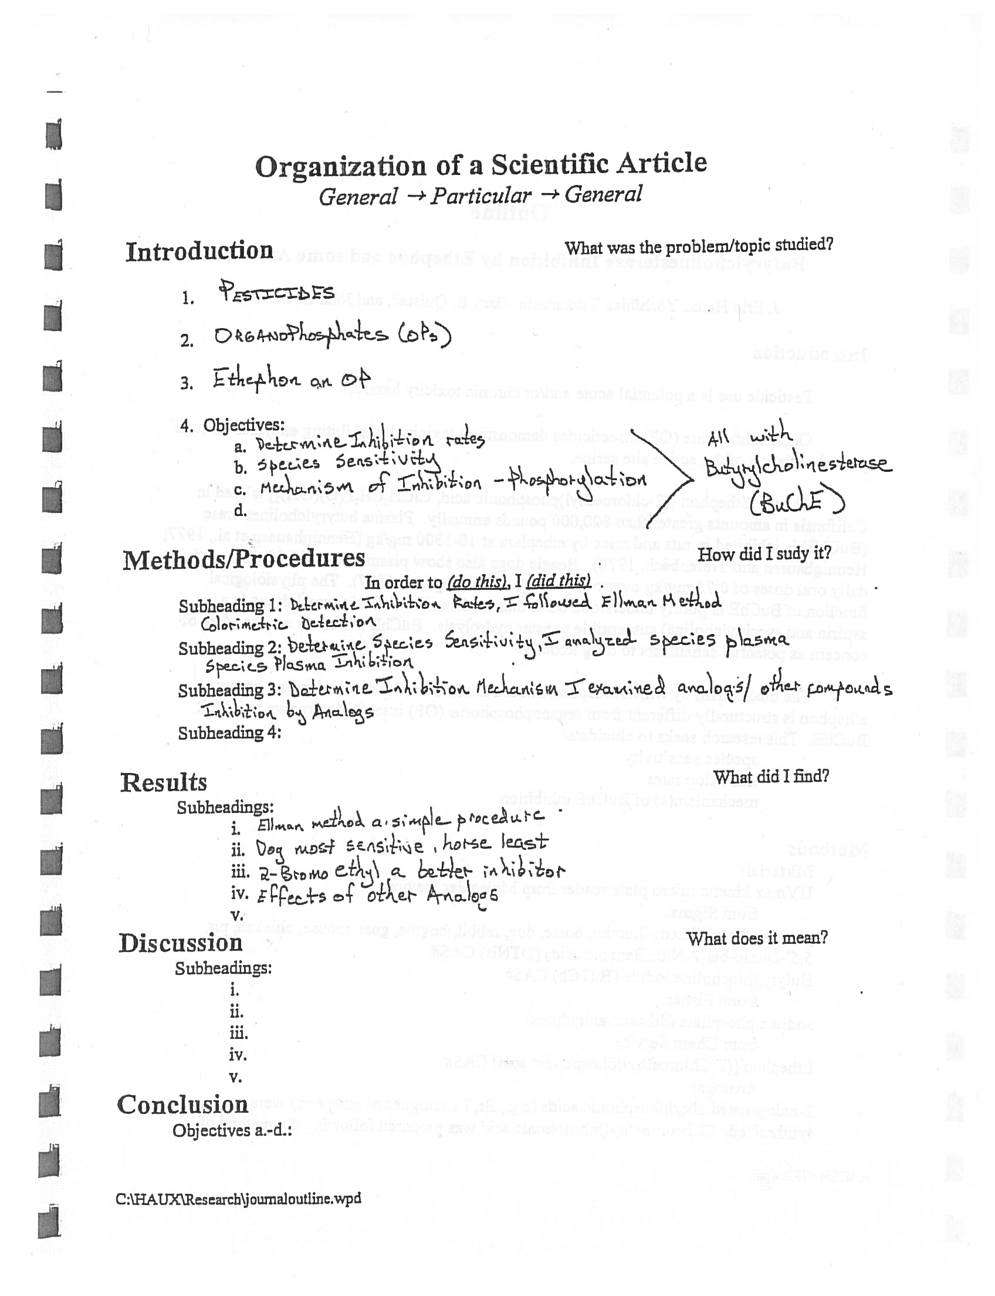
Getting Started

Slide 35
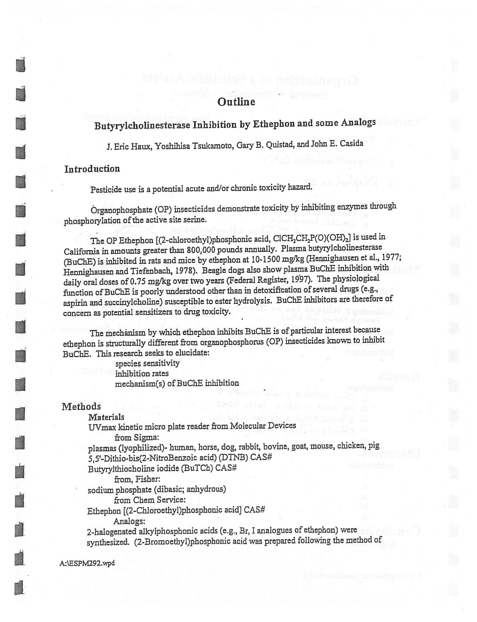
Getting Started

Slide 36
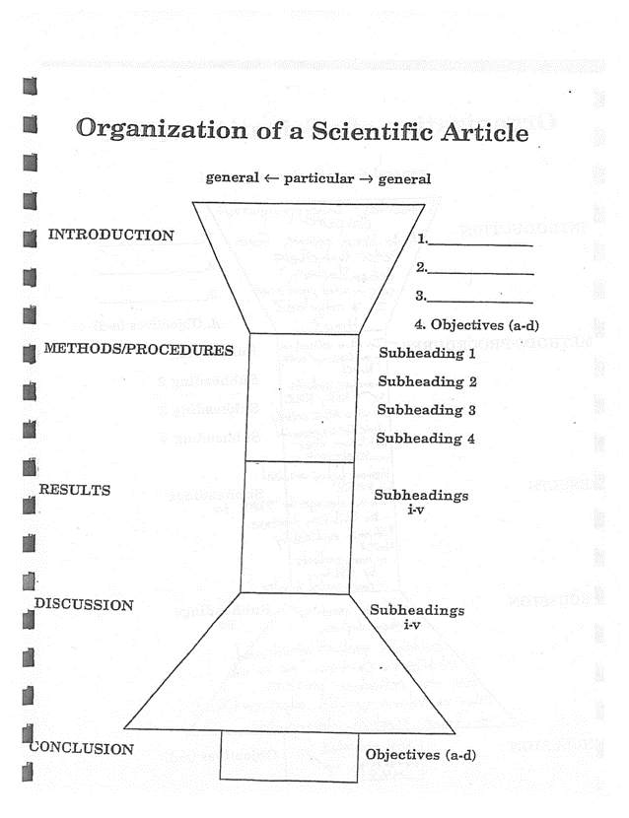
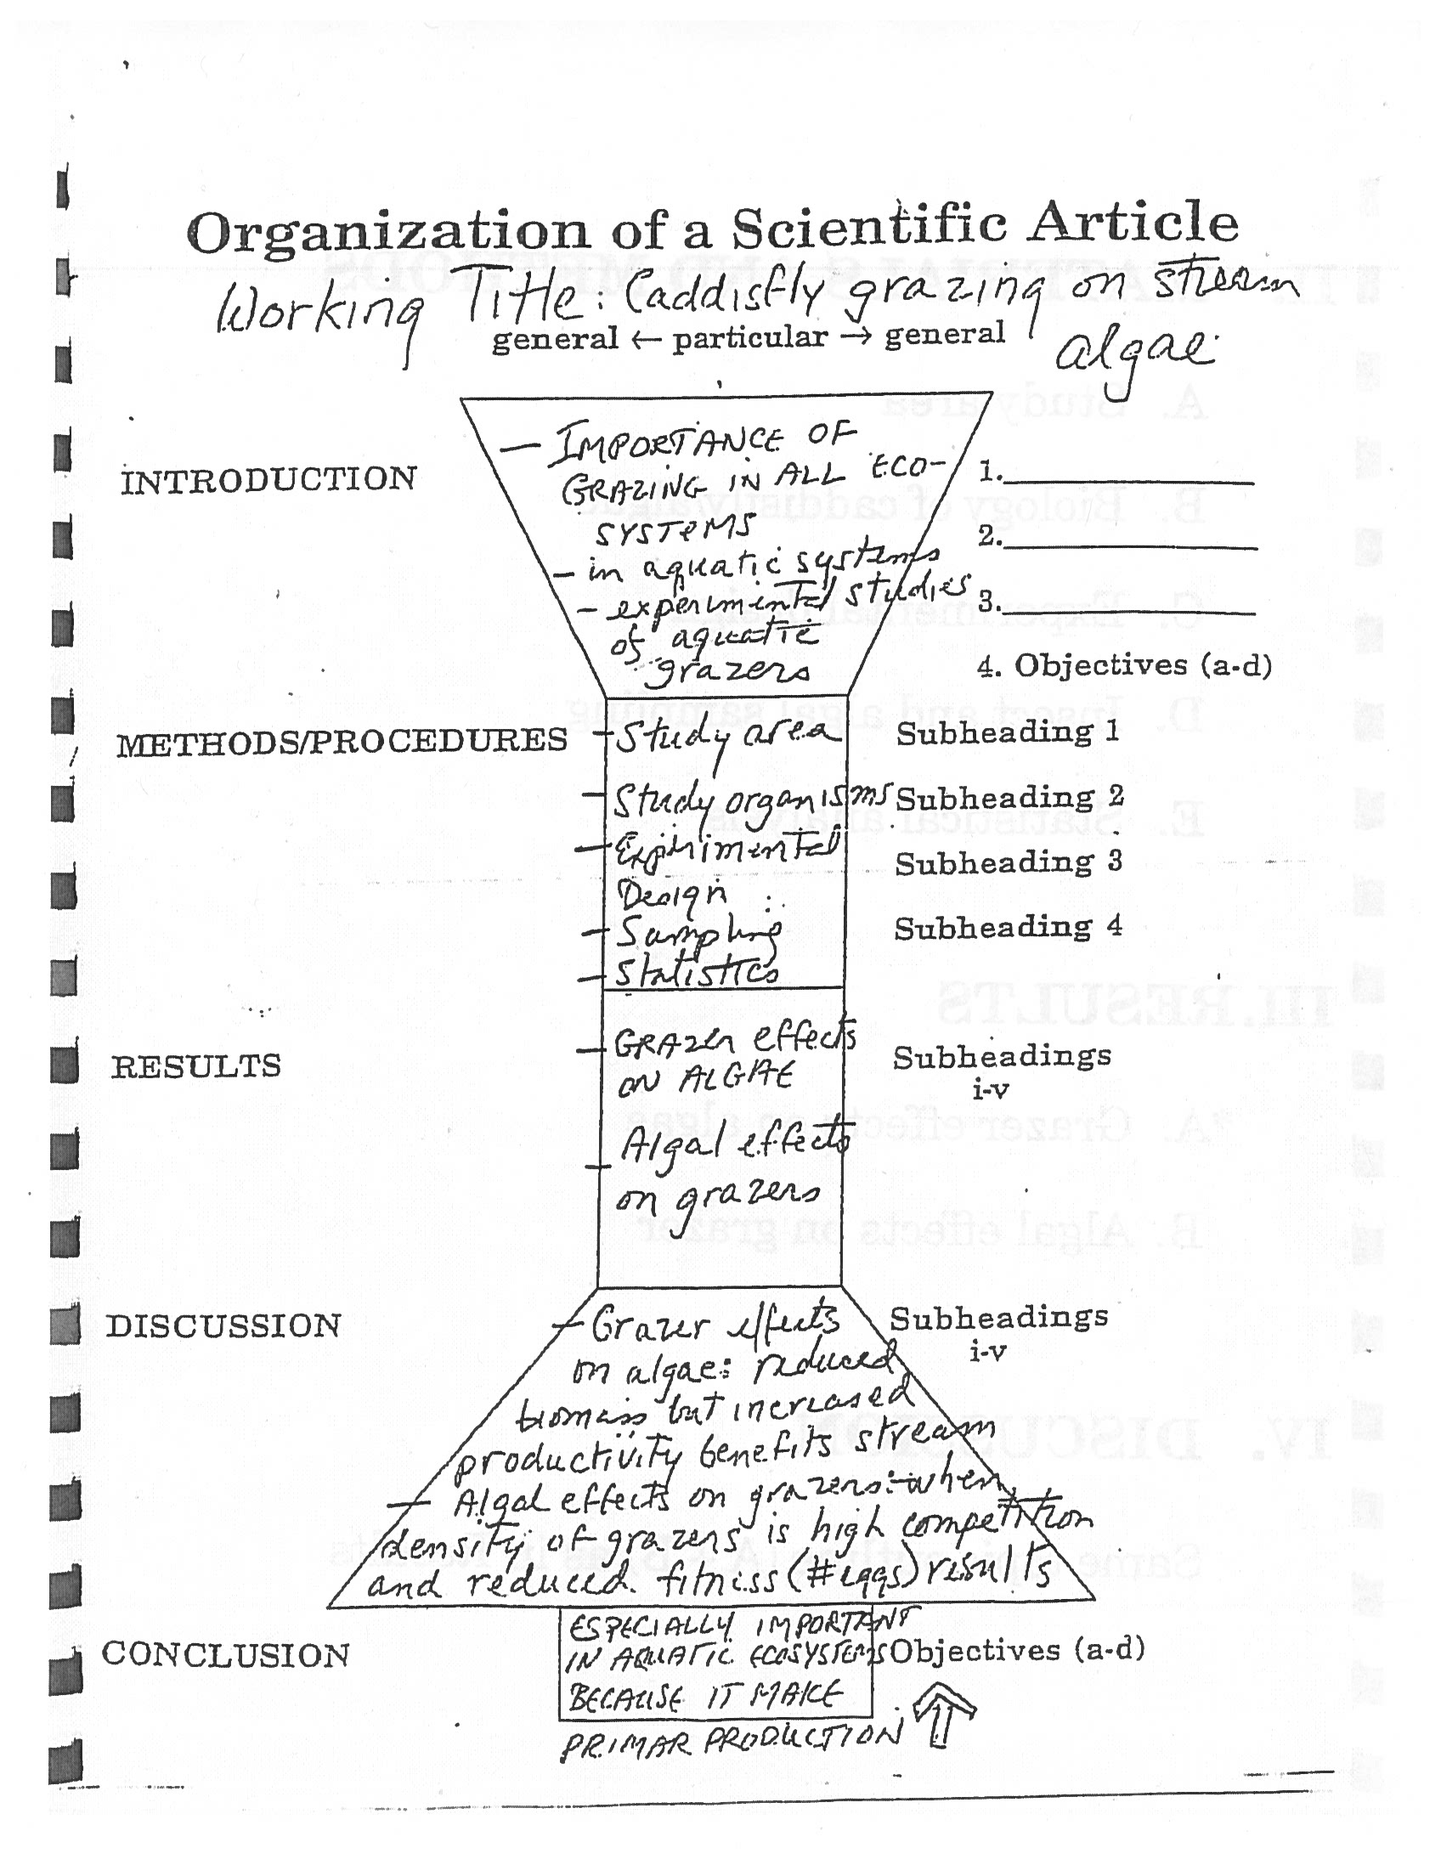
Getting Started

Slide 37

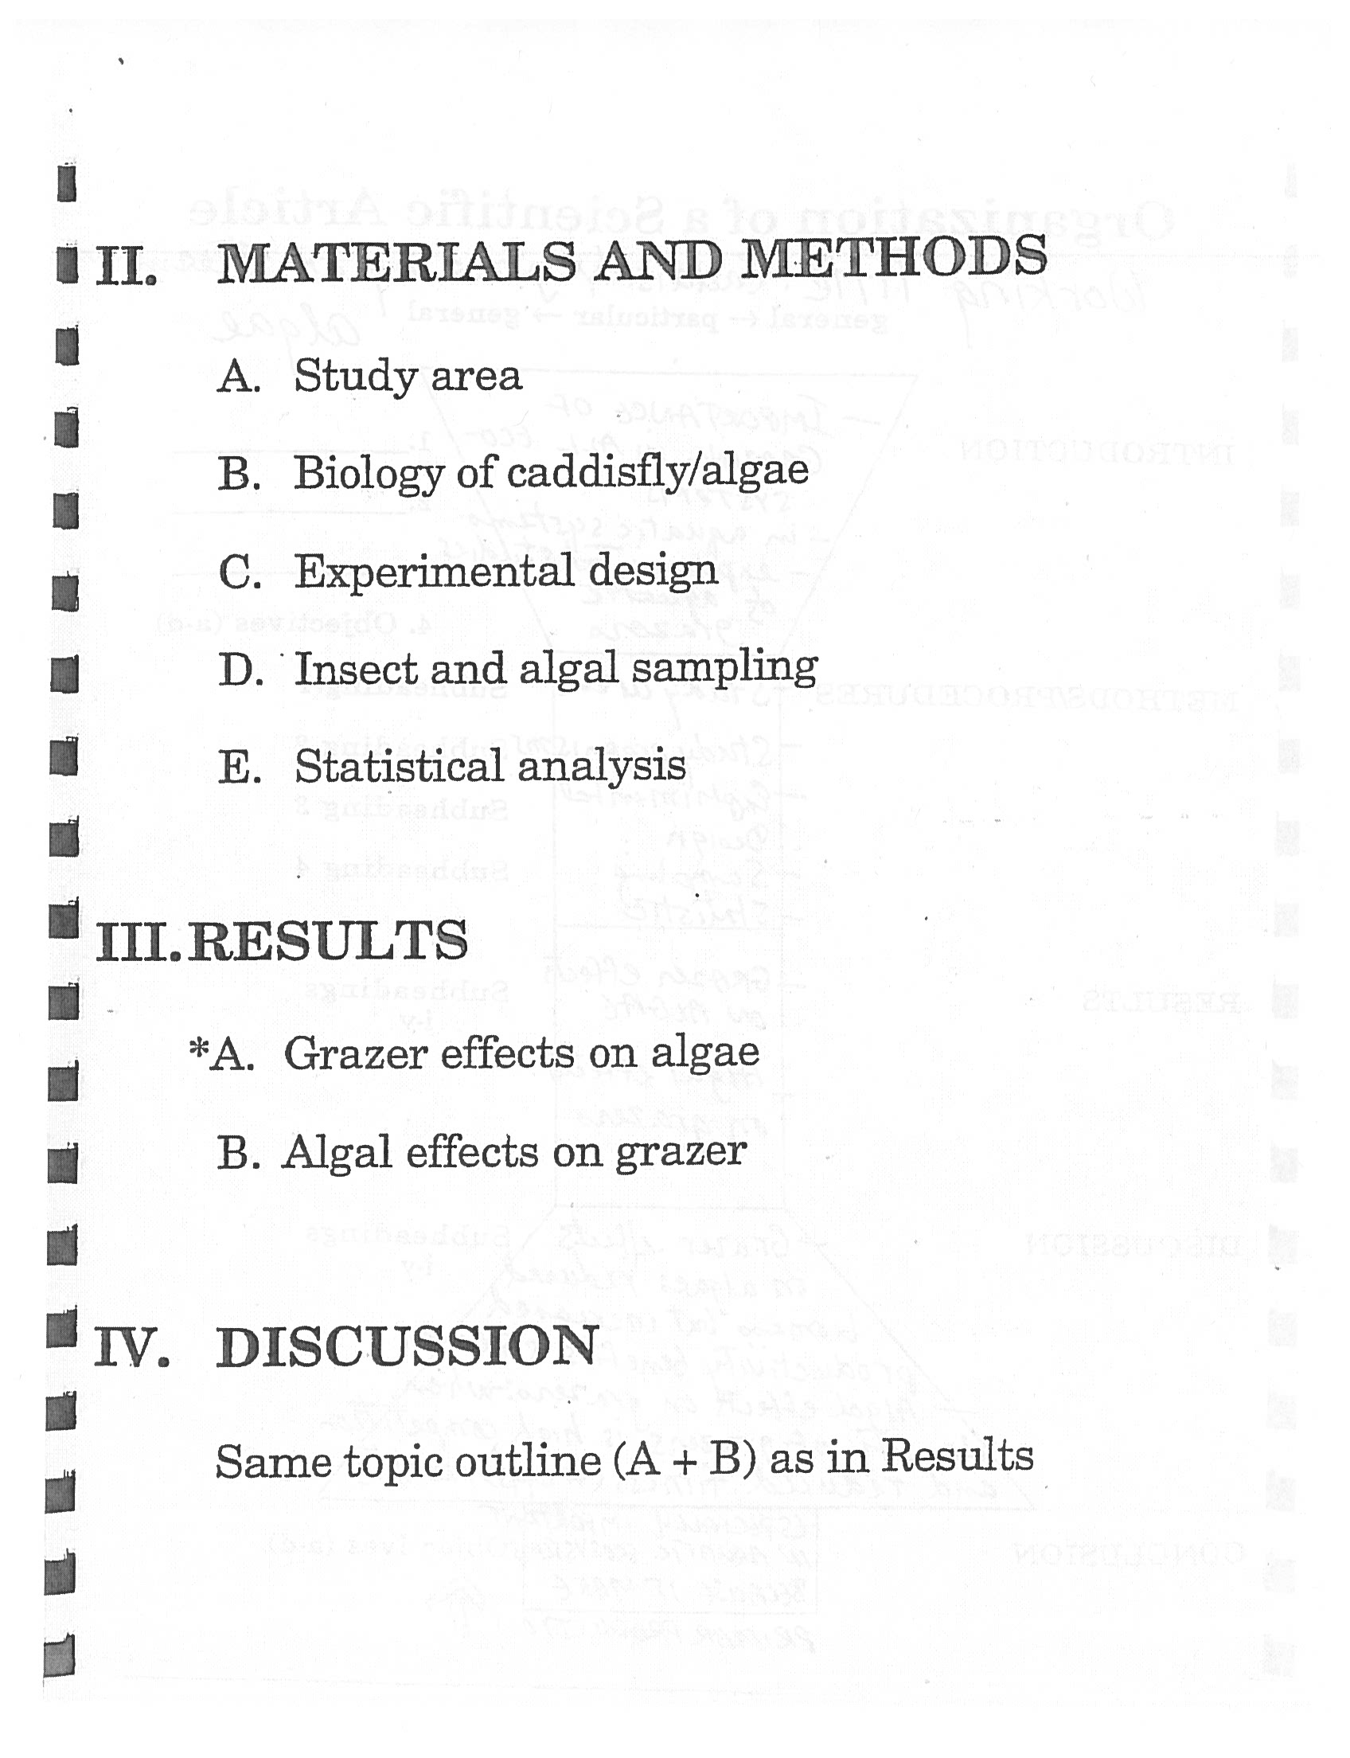
Getting Started

Slide 38
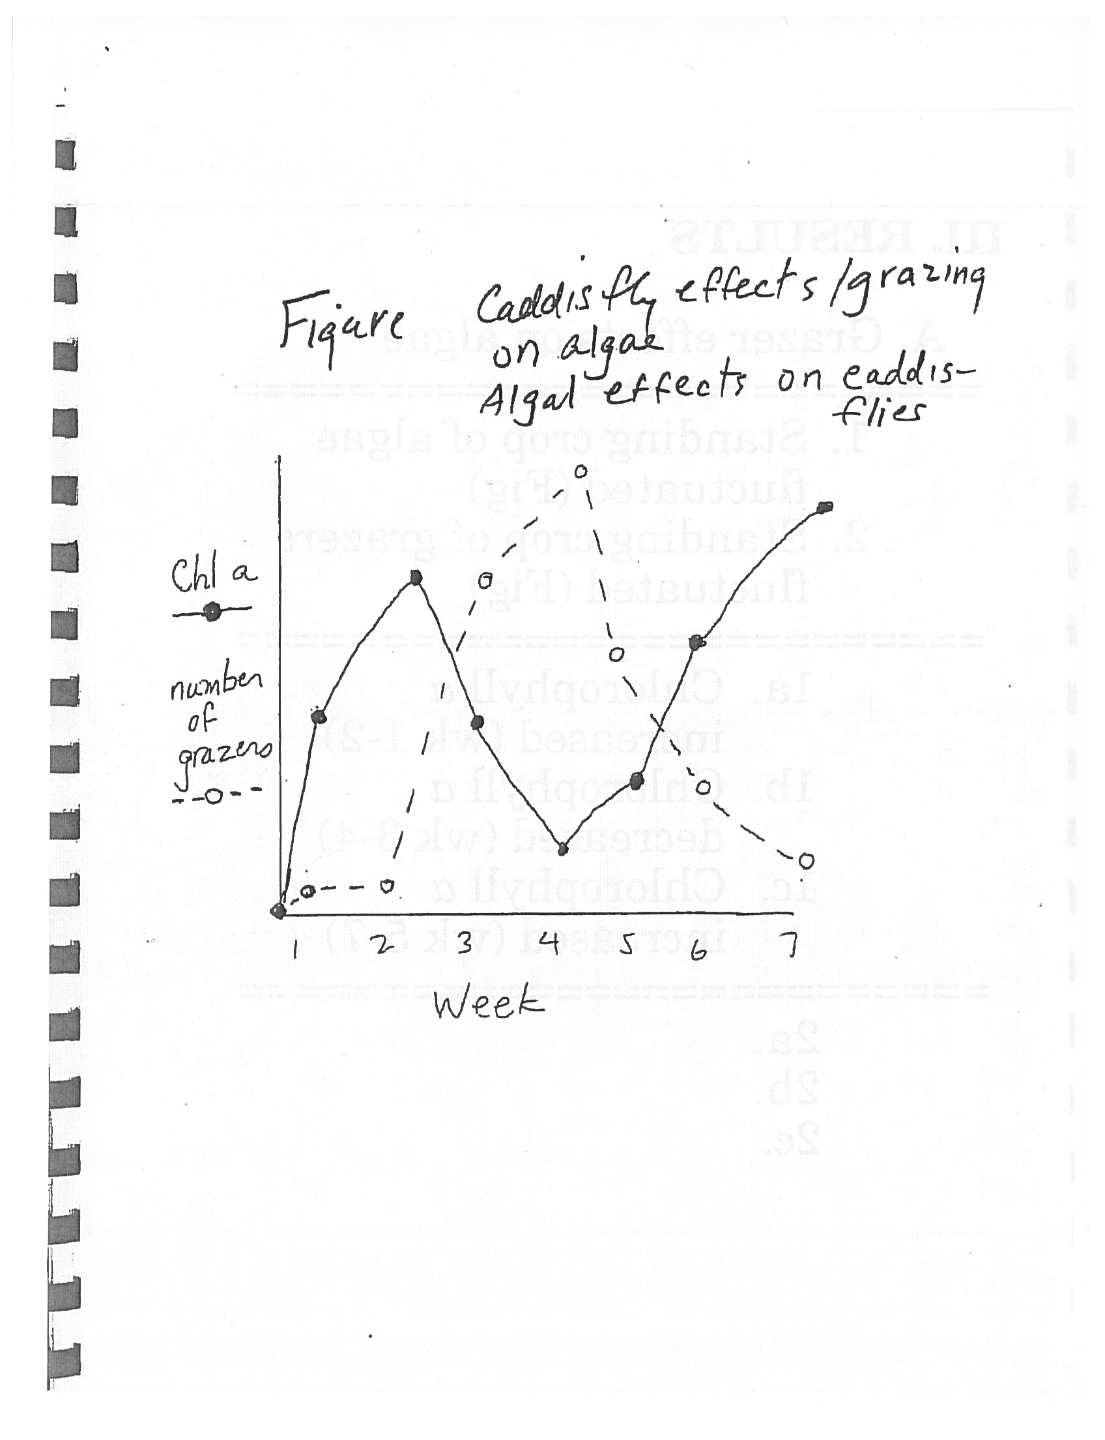
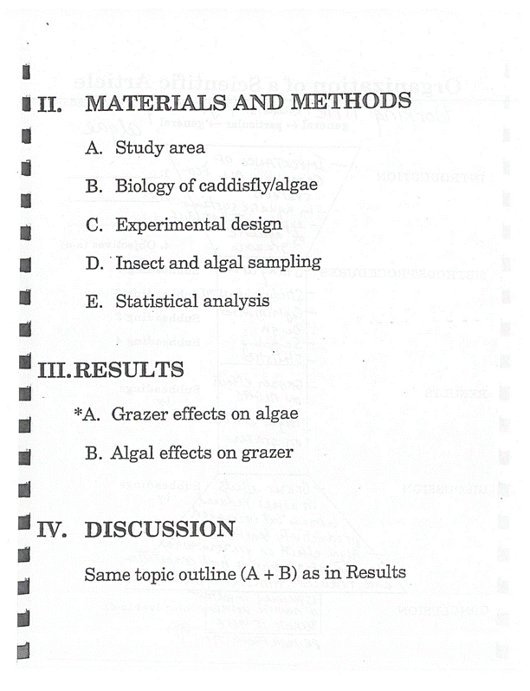
Getting Started

Slide 39
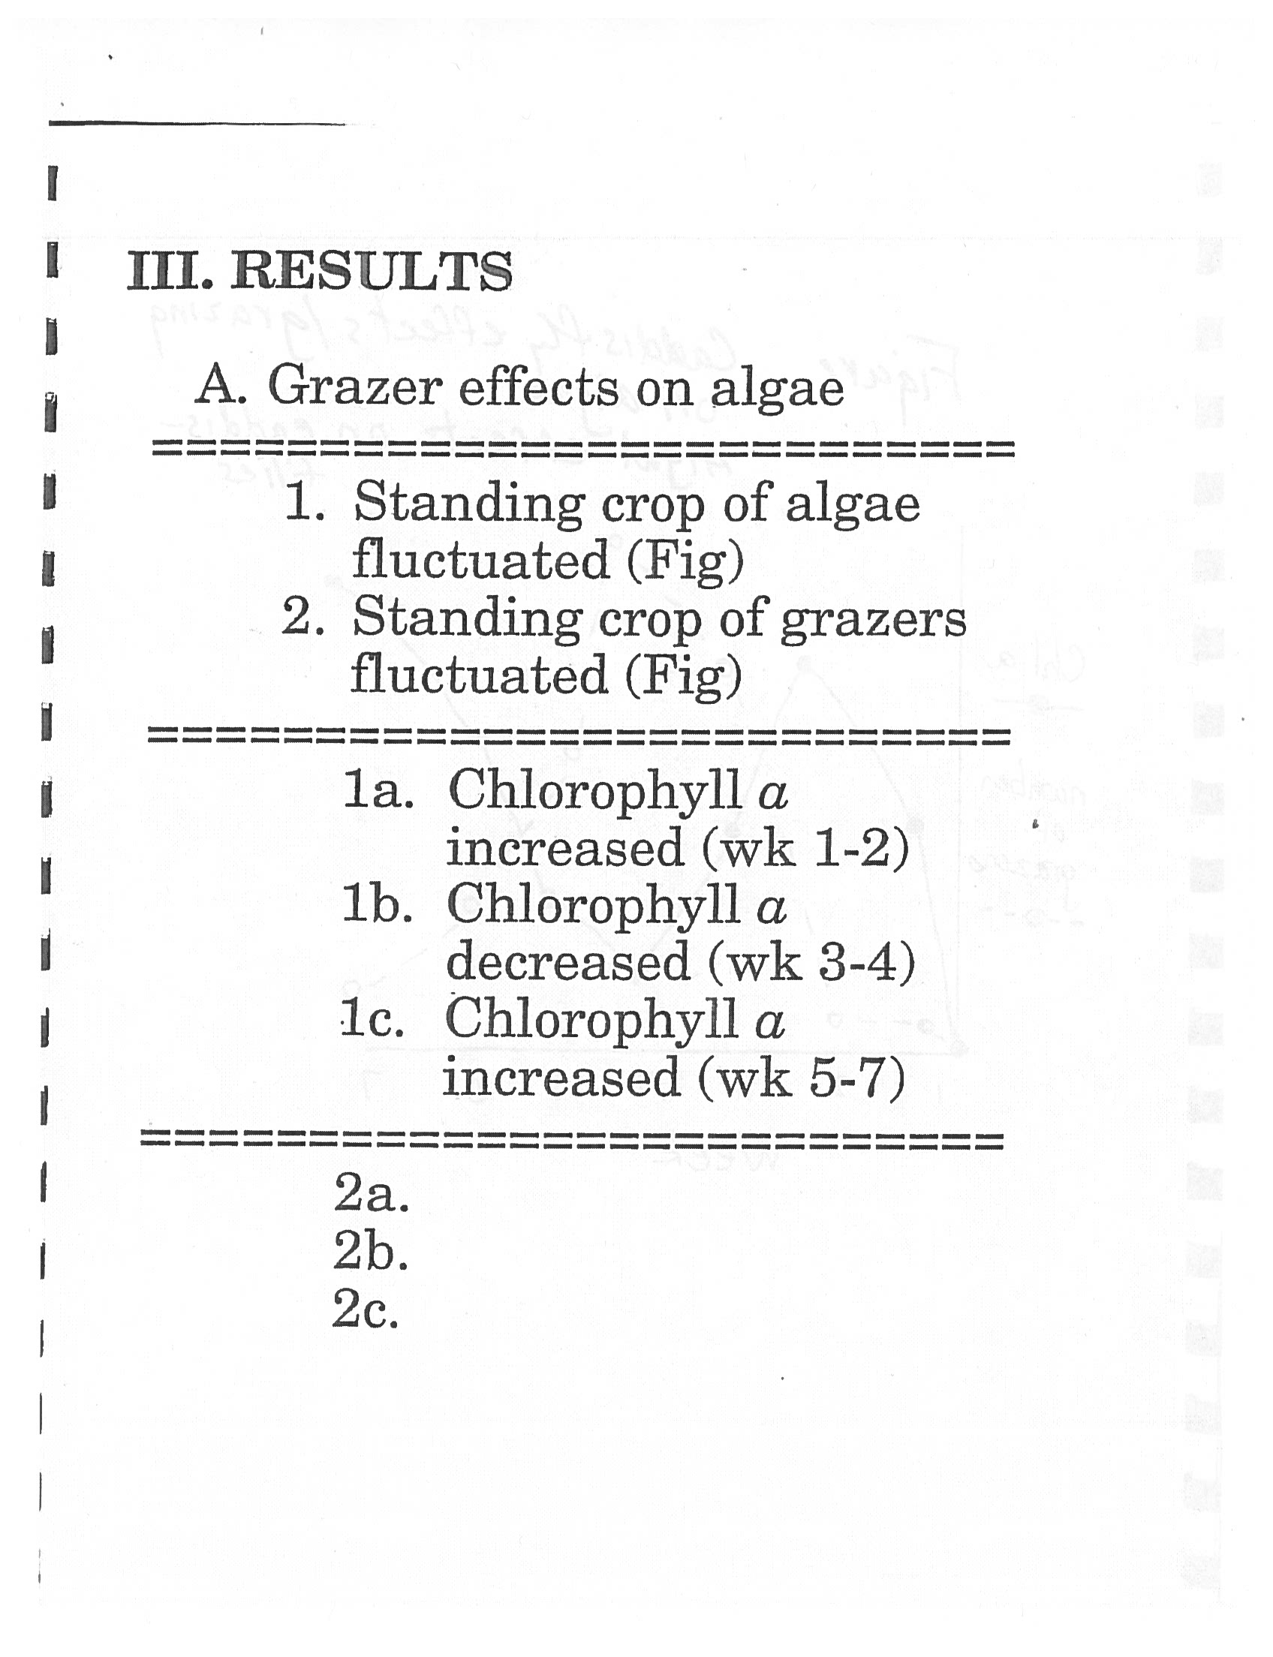
Getting Started

Slide 40
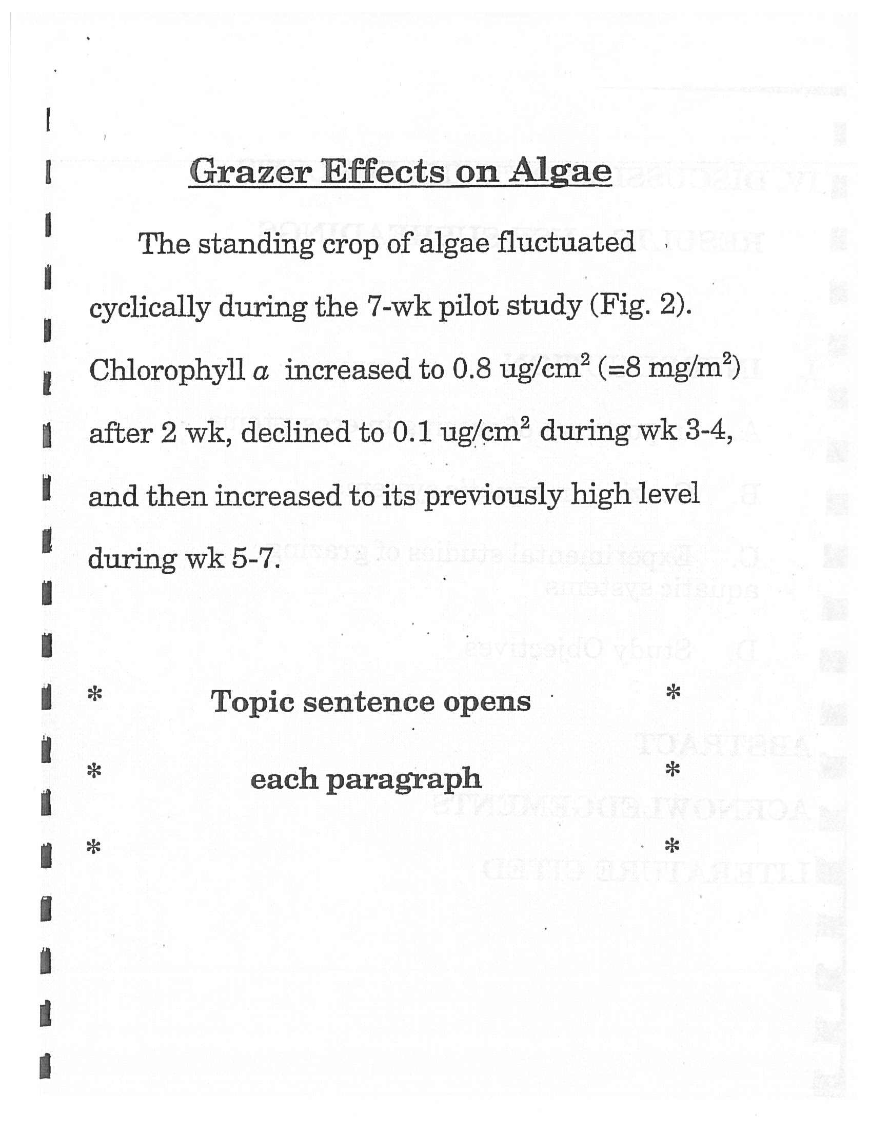
Getting Started

Slide 41
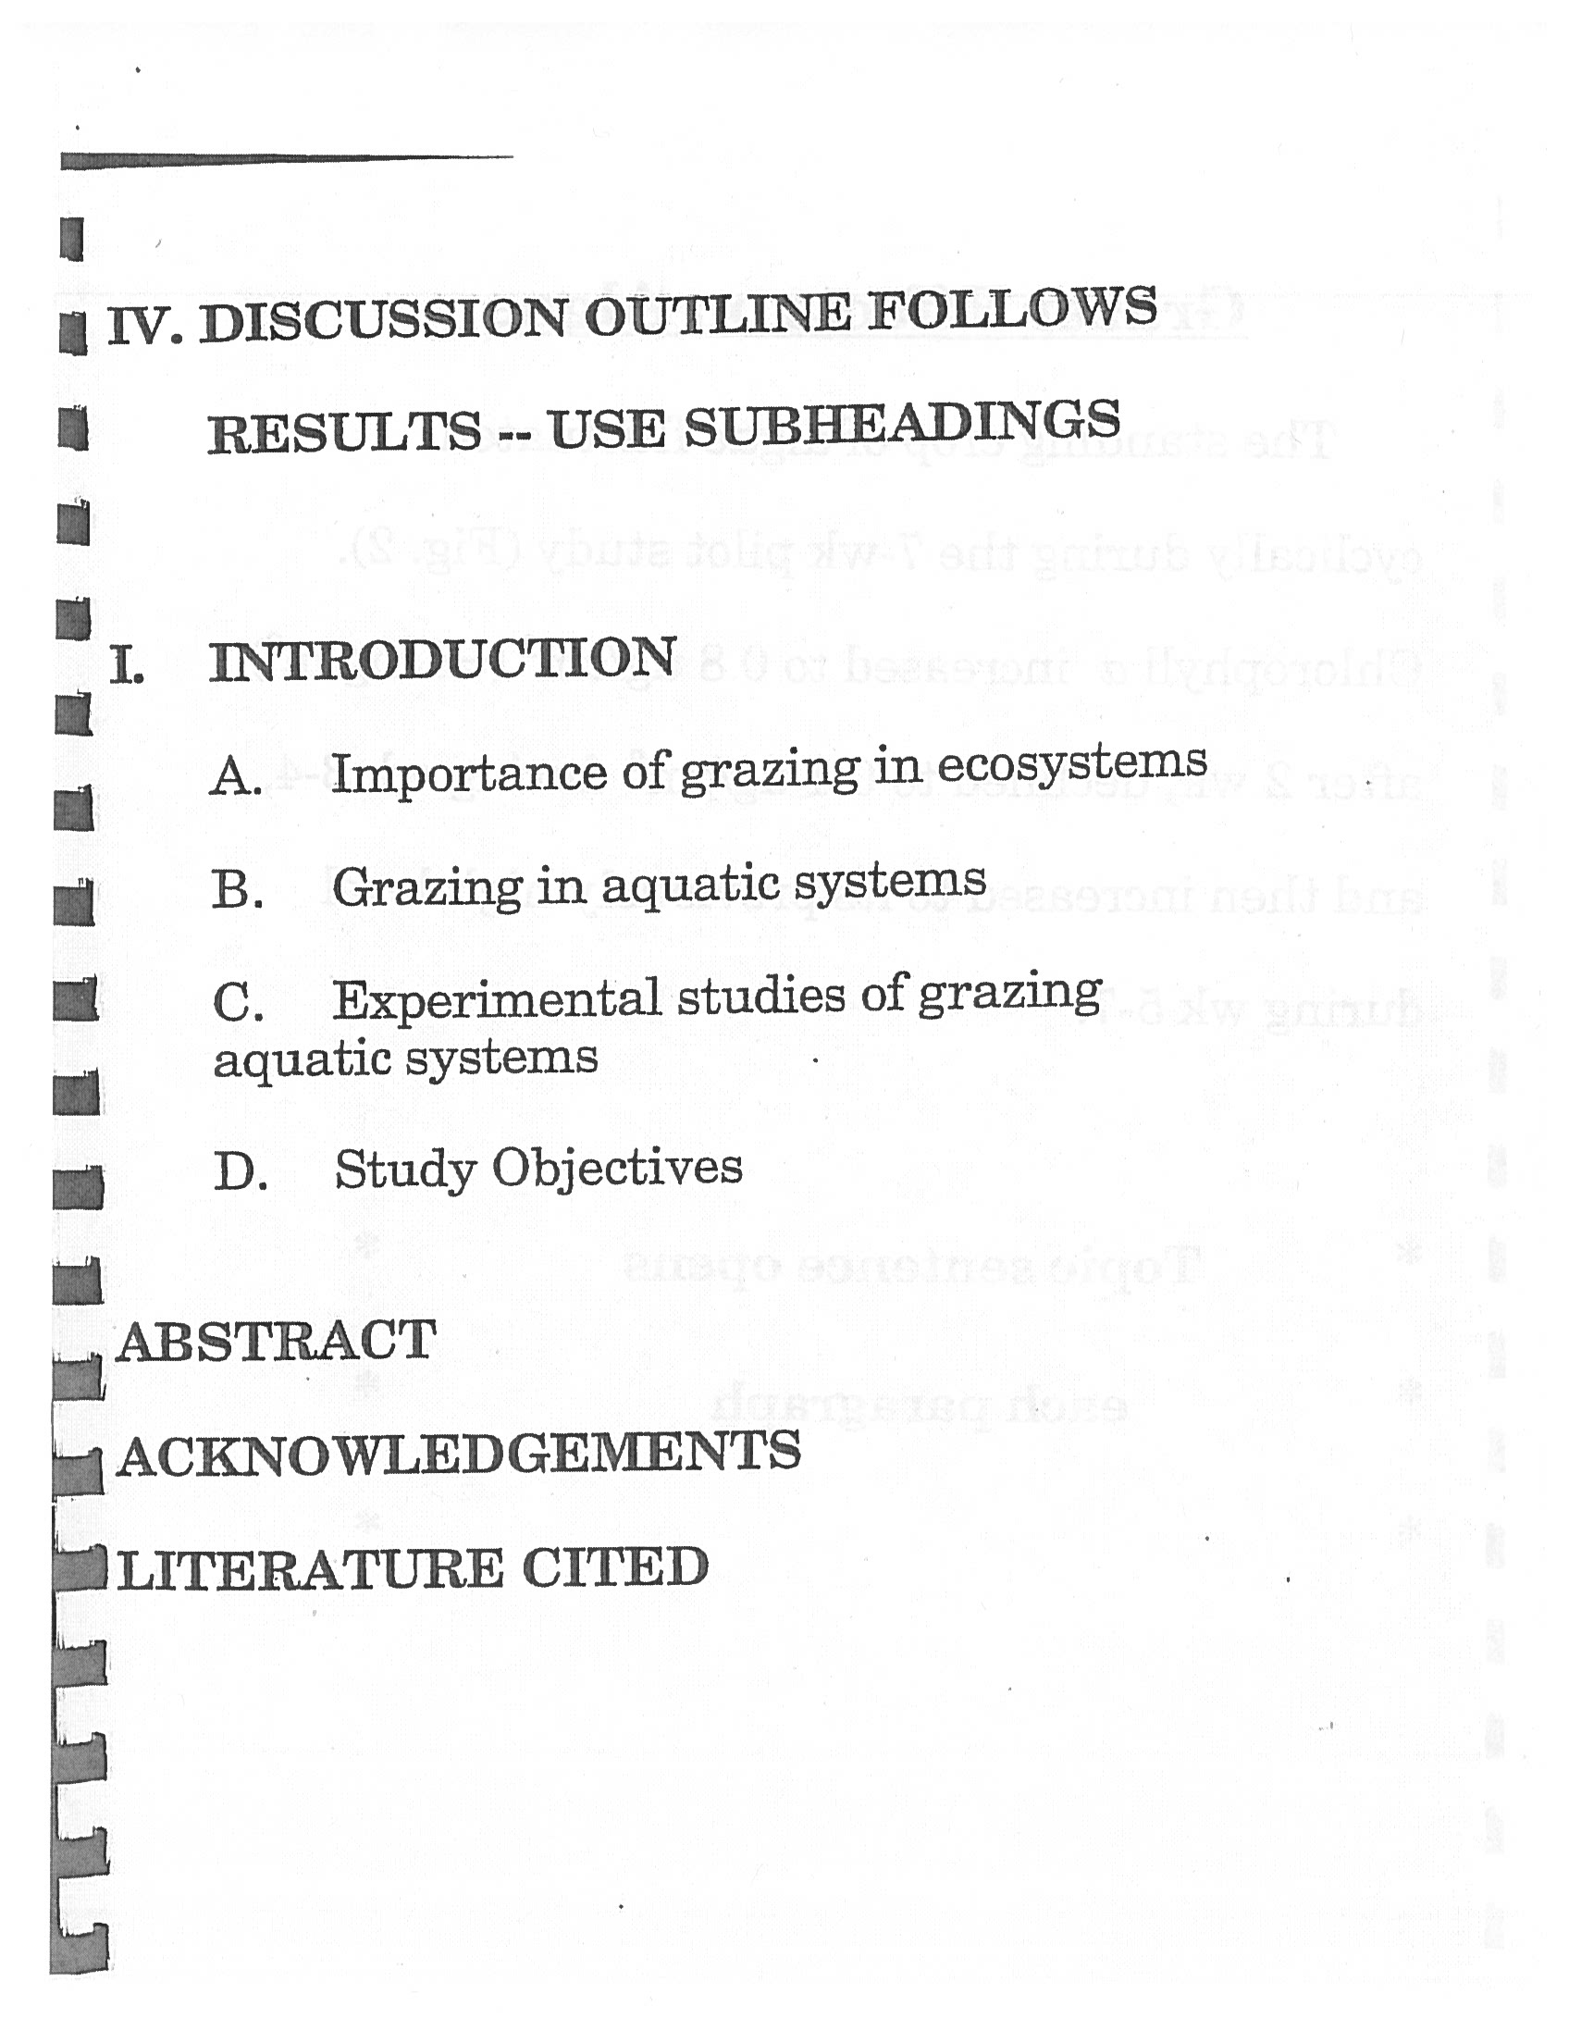
Getting Started

Slide 42
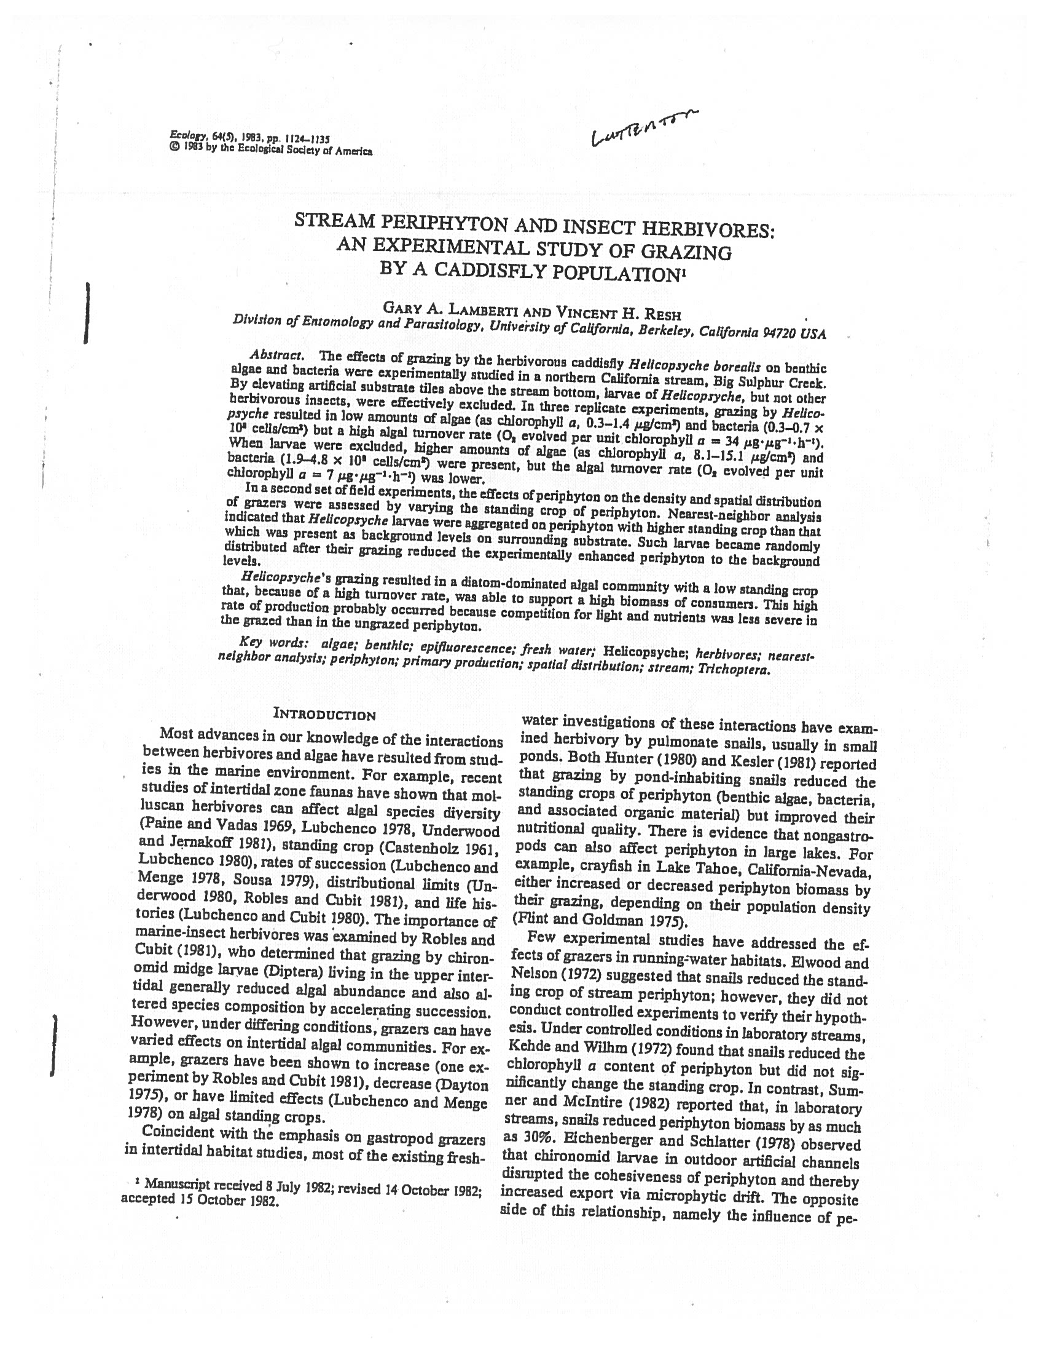
Getting Started

Slide 43

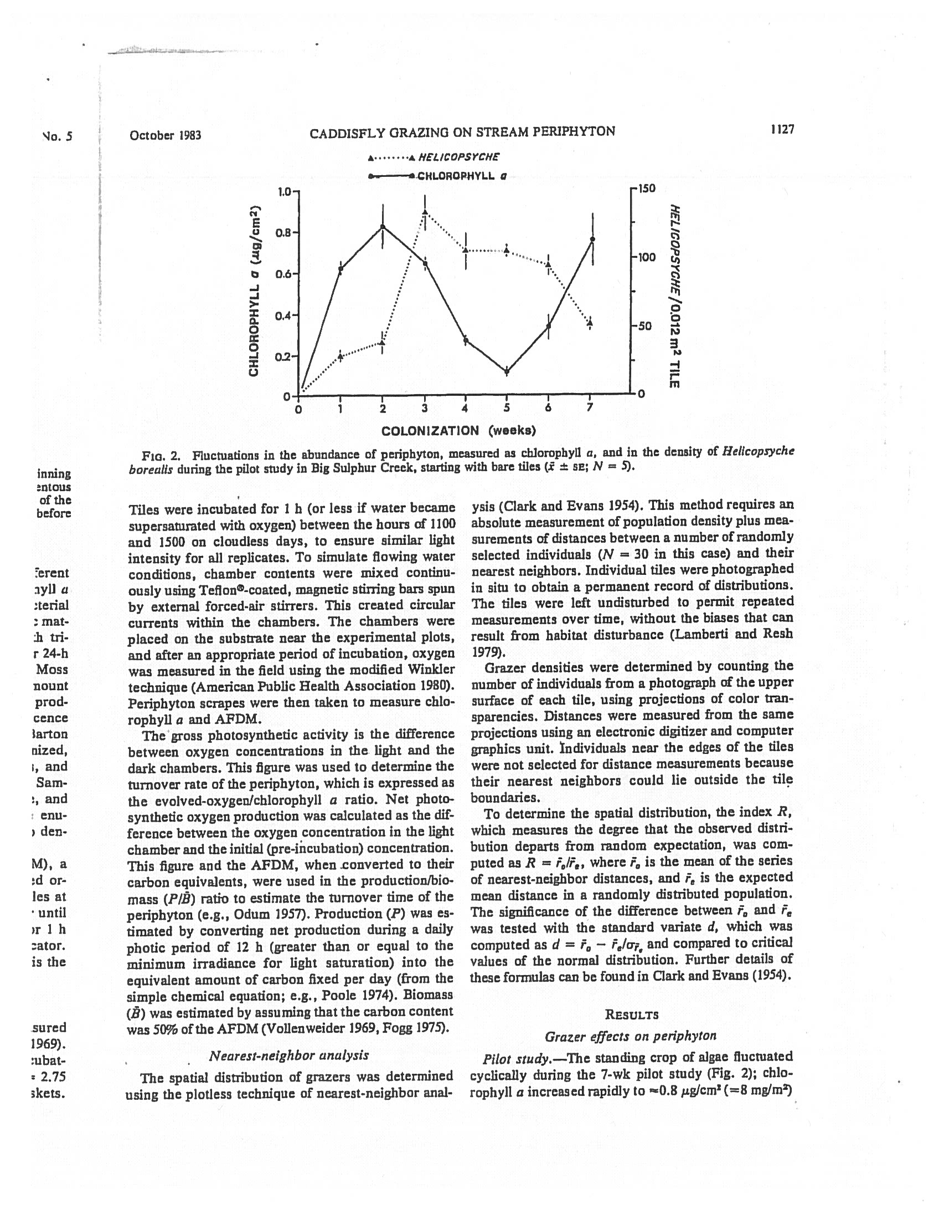
Getting Started

Slide 44

Finalizing the process

Slide 45
Defending the thesis or dissertation
All theses and dissertations must be publicly defended
A defense announcement must be posted electronically on an academic program or departmental website
A defense should consist of the following components:
An oral presentation by the student
An open question period for members of the audience in attendance
A closed question period that consists of committee members and the student
A closed session consisting of only committee members who deliberate on the performance of the student

Slide 46
Final submission requirements
Once the thesis/dissertation is approved by committee, academic dean, and the Graduate School, the student must submit the work to the university libraries for inclusion in ScholarWorks@GVSU
Must submit a PDF of the entire document to the Graduate School after the committee has signed the approval page
To submit a thesis/dissertation to ScholarWorks@GVSU, send a completed submission agreement and a PDF of the full, approved thesis/dissertation to scholarworks@gvsu.edu

Slide 47
Final submission requirements
The ScholarWorks@GVSU submission agreement includes an option to embargo a thesis/dissertation for a specified period of time after it is submitted
Abstract and title of an embargoed file will be visible online, but the thesis/dissertation itself will not be available to read or download until the embargo period ends

Slide 48
Final submission requirements
https://www.gvsu.edu/library/sc/

Slide 49
Dissemination guidance
The dissemination of the research and scholarship is critical to the thesis/dissertation process
Options
Presentation
GVSU events
State, regional, national, international presentations
Exhibitions
Showings
Publication (https://www.gvsu.edu/rcr/publication-practices-16.htm)
Journals
Technical reports

Slide 50
Conference/presentation support for graduate students
Financial support exists to help with the dissemination of research and scholarship
https://www.gvsu.edu/gs/academic-conference-fund-29.htm

Slide 51
Student resources for success
https://www.gvsu.edu/gs/graduate-student-resources-30.htm

Slide 52
Fred Meijer Center for Writing and Michigan Authors
https://www.gvsu.edu/wc/graduate-student-services-84.htm

Slide 53
Statistical Consulting Center
https://www.gvsu.edu/scc/

Slide 54
GVSU Speech Lab
https://www.gvsu.edu/speechlab/

Slide 55
Information resources
University Libraries & Subject Librarians
Knowledge Market
https://www.gvsu.edu/library/
https://www.gvsu.edu/library/km/

Slide 56
Data Inquiry Lab
https://www.gvsu.edu/datainquirylab/

Slide 57
Graduate School Thesis and Dissertation Coordinator
https://www.gvsu.edu/gs/jennifer-palm-20.htm

